Slide 1
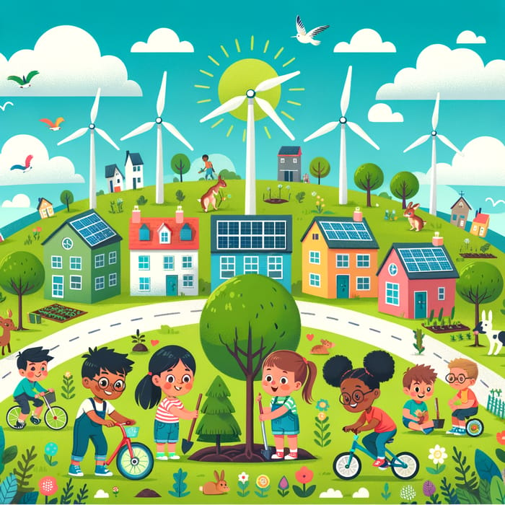
Sustainable City
Teacher Lina María Guasmayan Villarreal
Grade: 4

Slide 2
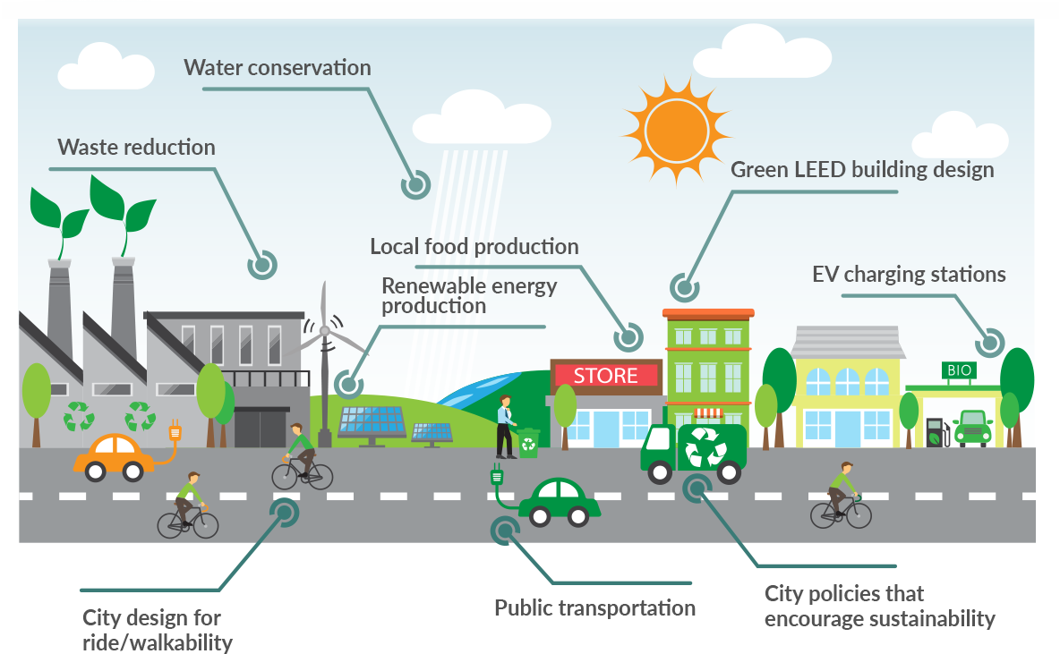
What Is A Sustainable City?
A sustainable city is a city that is resilient to the adverse impacts of climate change, identifies and reduces the vulnerabilities of its population and increases adaptive capacity, as well as manages disaster risks.

Slide 3
Question
For you, what is a sustainable city?

Slide 4
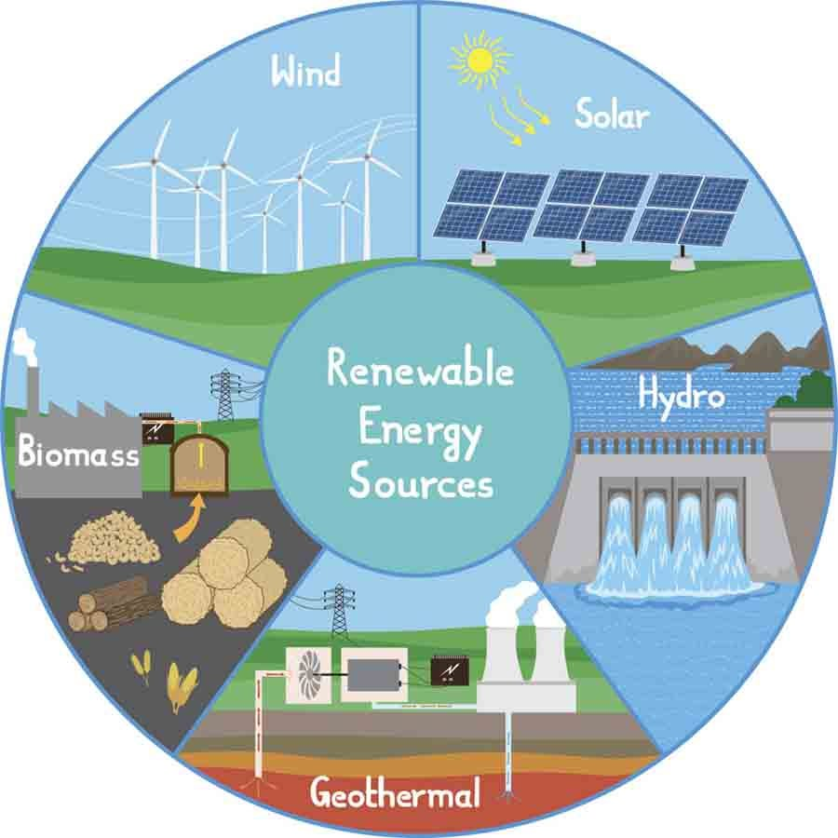
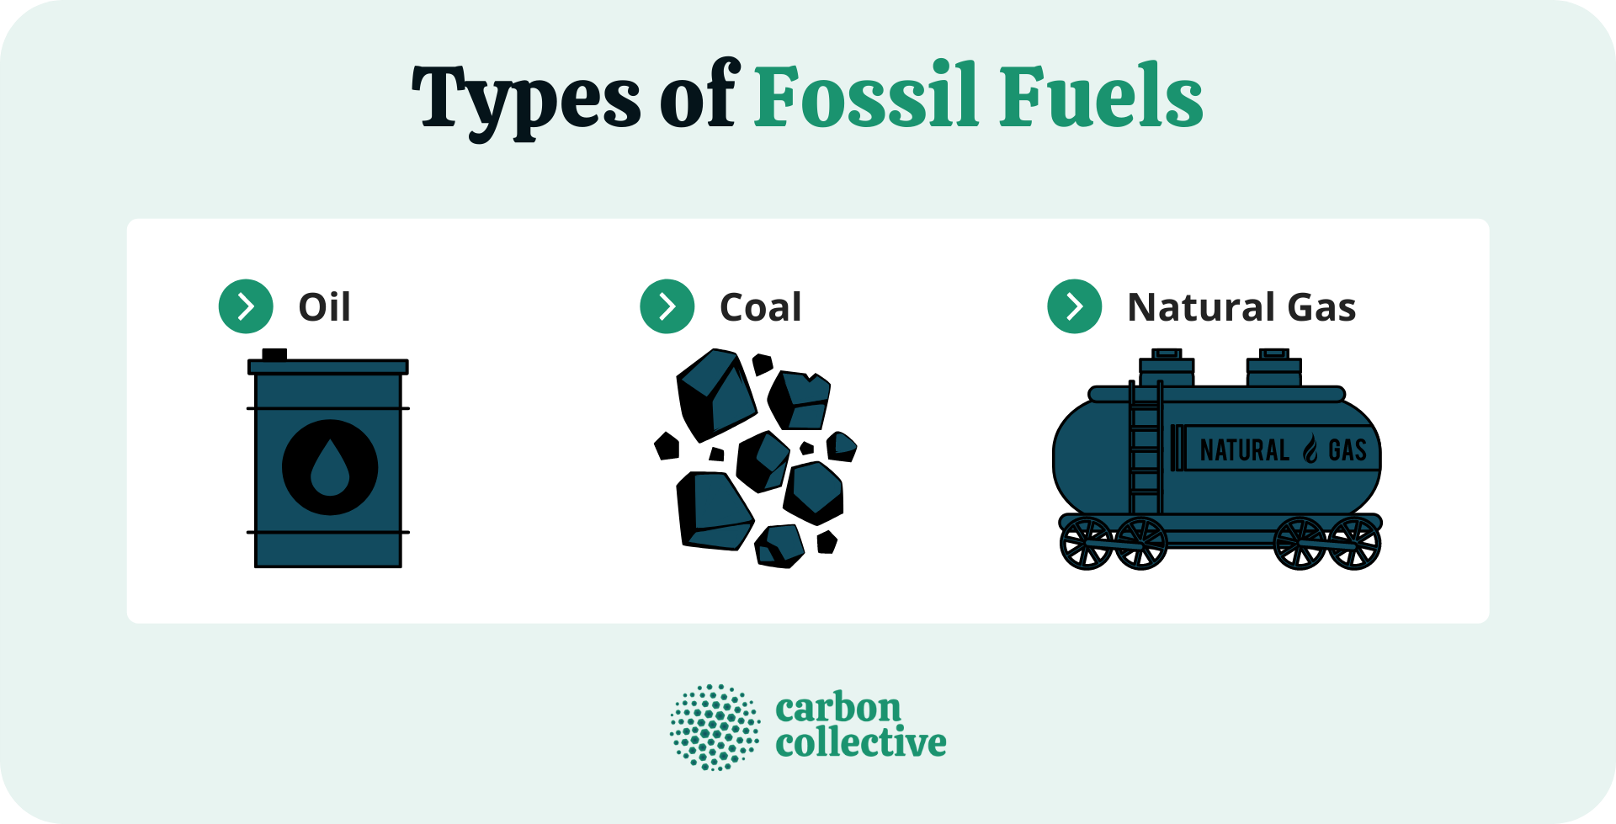
How Can We Build A Sustainable City? 1. Clean Energy
Today, they use almost 80% of the world’s energy, most of which comes from burning fossil fuels. This is not sustainable in the long run as fossil fuels are not renewable – meaning they are a finite resource. Many scientists think that we will run out of fossil fuels within this century. To make cities sustainable, we need to power them with clean energy such as solar and wind energy. These energy sources are renewable, which means that they will never run out.

Slide 5
Activity # 1
Write in your notebook a renewable energy.

Slide 6
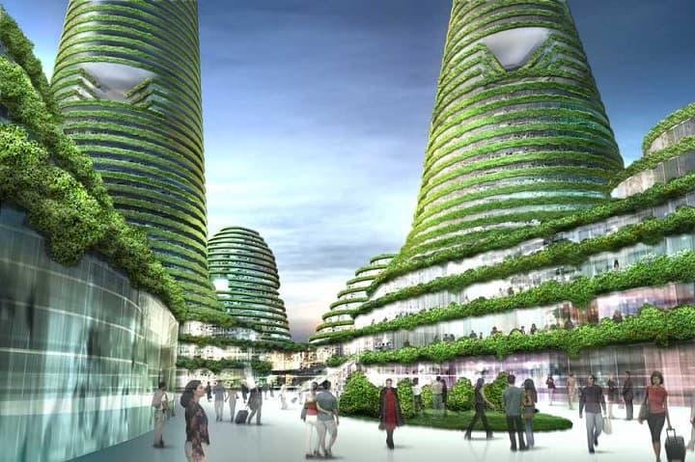
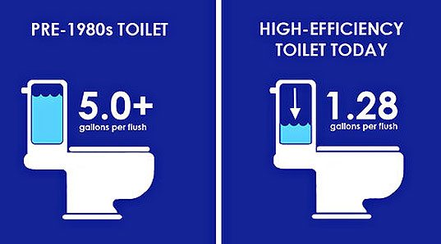
2. Green Buildings
As the urban population grows larger, cities need more homes, facilities, and work spaces to accommodate everyone. It is important that we build them in a way that reduces their impact on the environment. One way to do so is to build them with materials that are environmentally friendly. We can also design them to be more energy-efficient. Low-flow toilets, for example, can save water, while a “cool roof” that absorbs less heat can save energy by naturally keeping the building cool. Green buildings may even have their own solar panels to generate their own energy from the sun.

Slide 7
Activity # 2
Tell me an example about how we can save energy in our homes.

Slide 8
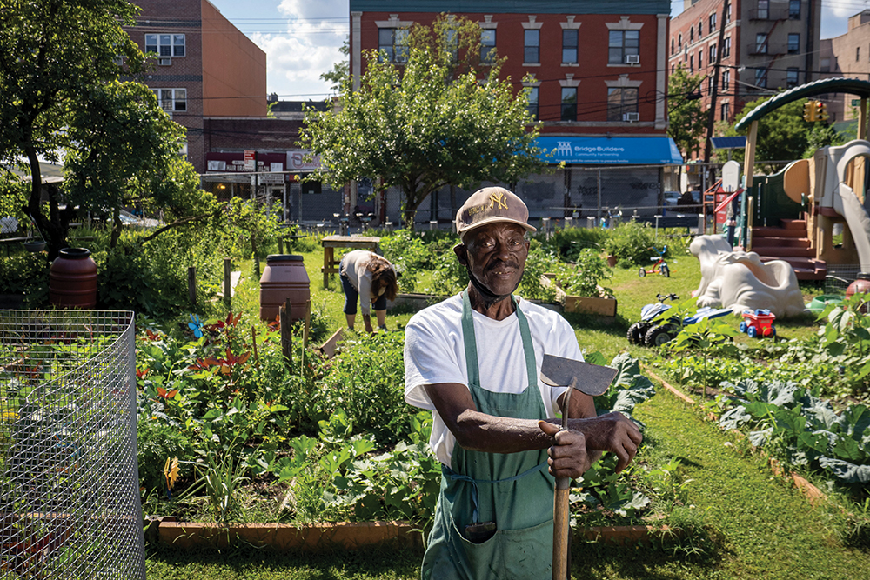
3. City Farming
You may have heard of rooftop farms and vertical farms – they are both examples of city or urban farming. A city may not have space for big farms, but it will likely have pockets of green spaces. City farming is the use of these spaces to grow produce and even raise small animals such as chickens. While we cannot rely on them to feed an entire city, tiny farms are a great source of food for small communities and neighbourhoods.

Slide 9
Activity # 3
If you had a green small place in your city, what would you like to plant?

Slide 10
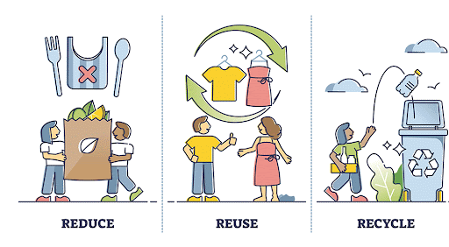
4. Waste Management
Waste management is a big problem in the world today. According to experts, we dump at least 2 billion tons of waste globally each year. Through recycling, reducing and reusing, cities can prevent waste from ending up in landfills. In San Francisco, for example, recycling and composting laws have helped the city cut 80% of its waste!

Slide 11
Activity # 4
Write the three R that were mentioned in the text.

Slide 12
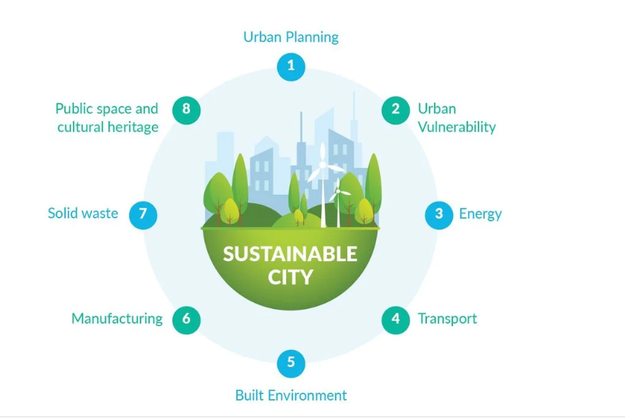
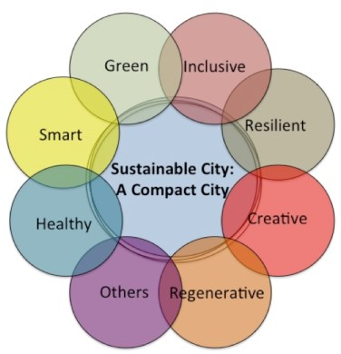
Characteristics of a sustainable city

Slide 13
Video: Sustainable Cities and Communities
https://www.youtube.com/watch?v=7hEYtozmb5o

Slide 14
Old City | Sustainable City
1. 2. 3. | 1. 2. 3.

Slide 15
Activity # 5
Draw your Sustainable city and say why it is sustainable.

Slide 16
Webgraphy
https://paryavaranmitra.wordpress.com/2021/09/03/my-vision-of-an-ideal-future-sustainable-city/
https://kids.earth.org/life-on-land/how-can-we-build-a-sustainable-city-a-kid-friendly-guide/

