Slide 1
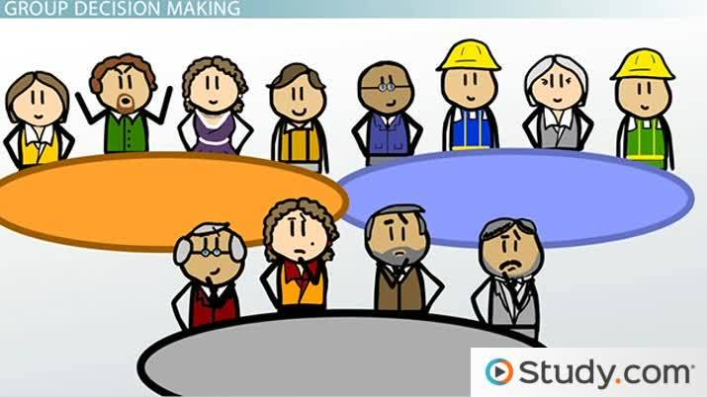
Final Project
Step 1
Make the groups (fables)

Slide 2
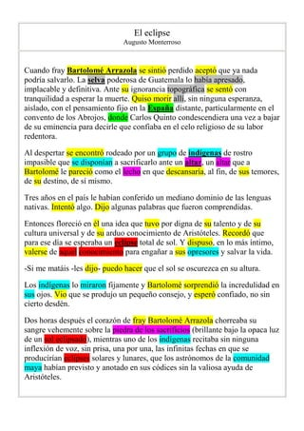
Step 2
Read the text and underline the uknown words and write the meaning in spanish.

Slide 3
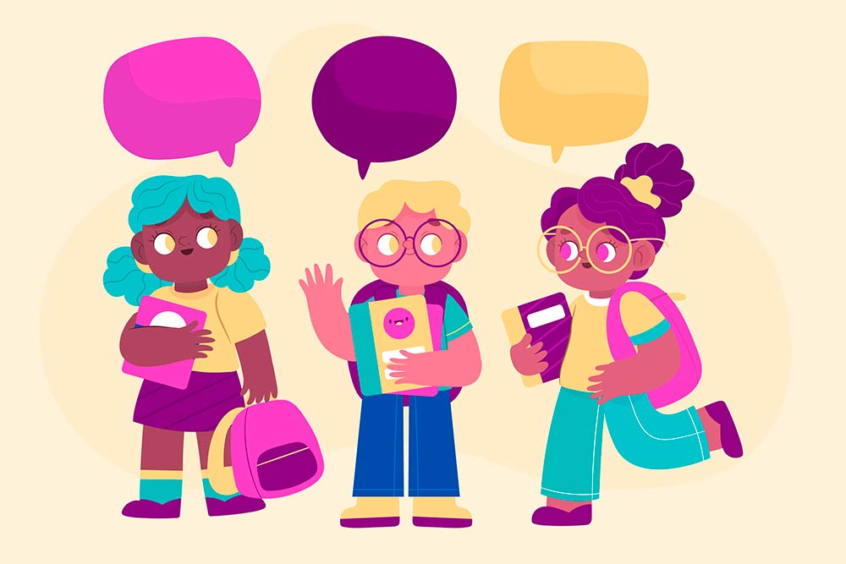
Step 3
Socialize the stories in the class. (Summary nad moral)

Slide 4
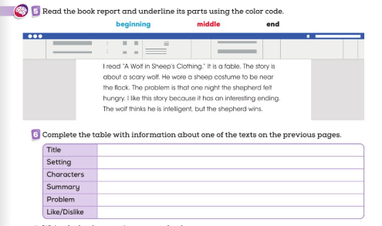
Step 5
Based on your fable, complete the information of your fable with this chart.

Slide 5
Step 5
Create a presentation in power point or canva taking into account this chart.
This information you have to complete with the fable assigned in the class.

Slide 6
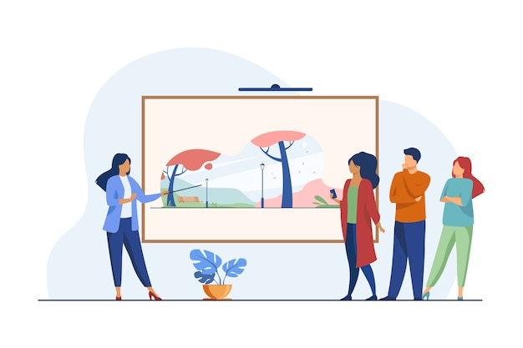
Step 6
Present the power point or canva presentation in the class.

