Slide 1
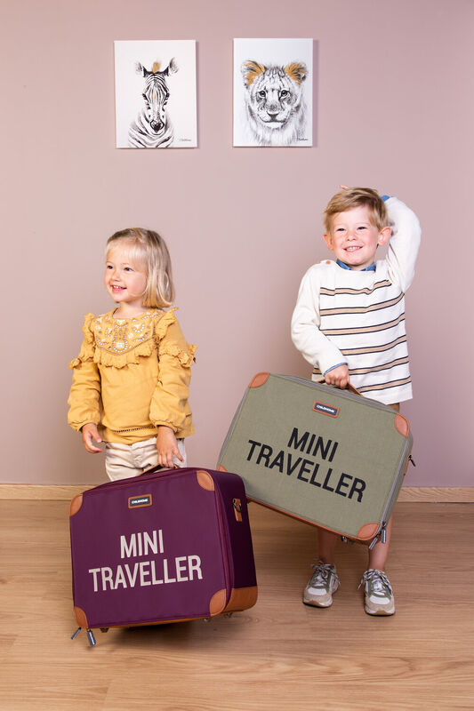
Mini Traveller
4 Grade

Slide 2
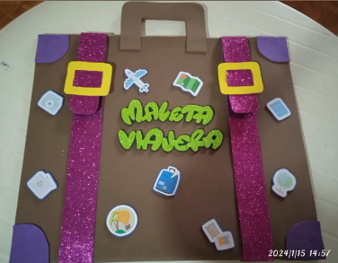

Slide 3
Step 1
Let´s do two straps of the suitcase.

Slide 4
Step 2
Let´s draw the buckles of the suitcase.

Slide 5
Step 3
Let´s draw where we grab the suitcase

Slide 6
Step 4
Let´s color the stickers of the decoration of our suitcase.

Slide 7
Step 5
Let´s write the Word Mini Traveller

Slide 8
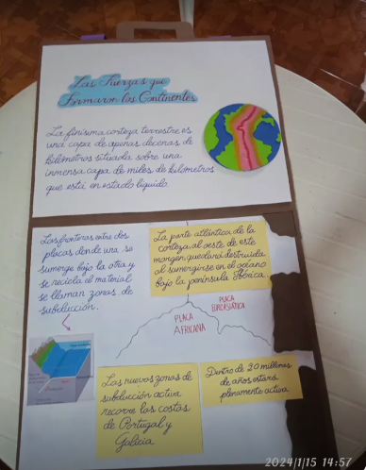
Step 6
Let´s complete an information with the trips that we have done.

